Slide 1
Learning to play MOBA games using Neural Networks and Reinforcement Learning
Research Project for the degree of Master of Science in Computer Science
Janine Weber
Supervisors: Rolf Fagerberg, Marco Chiarandini
University of Southern Denmark
January, 2017
Notes:
My name is Janine. For my master thesis I decided to combine one of my greatest curiosities, namely the study of Artificial Intelligence, with one of my biggest passions: games. Thus, my project became ”learning to play moba games using nn and rl”

Slide 2
Outline
Introduction
Related Work
Methods
Application
Experiments and Results
Conclusion and Future Work

Slide 3
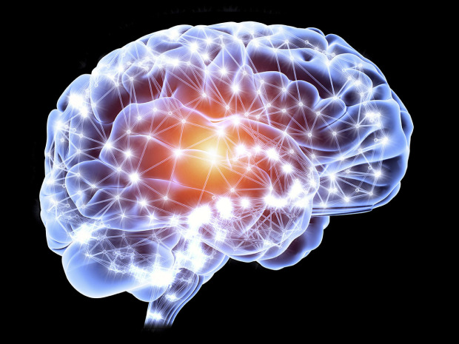
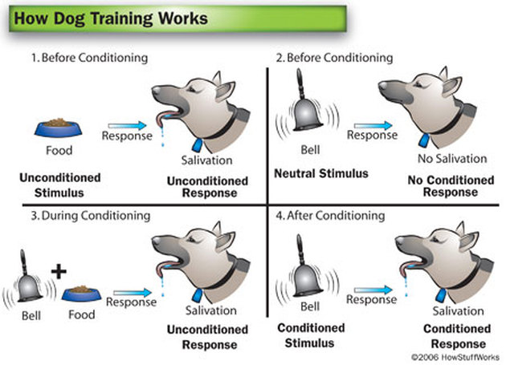
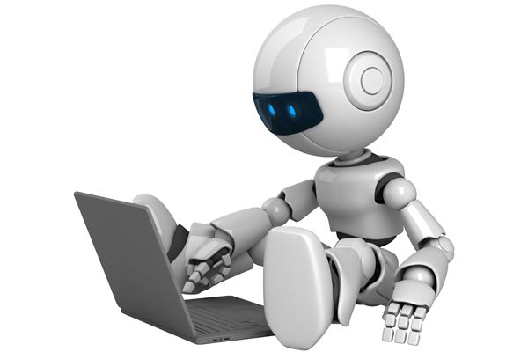
Introduction Motivation
Market research (2014)
~1.7 billion people playing video games
~1.6 billion people active in traditional sports
MOBA (multiplayer online battle arena)
Real-time strategy
Fast paced action
Hard-coded AI
+
Notes:
In 2014 a market research showed that the number of people playing video games is comparable to the number of people participating in regular sports.
MOBA games are video games that combine real-time strategy with fast paced action. Accordingly these games are often way too complex for hard coded AI agents to perform satisfactory.
Hence, in AI development, human concepts have often been used as an inspiration for computational models.

Slide 4
Introduction Aim of Thesis
Objective
Investigate if and to what degree agents can be taught to play a MOBA game.
Methods
Implement a learning agent
Train through self-play
Test value of agent against original game AI
Results
First learning agent for a MOBA game
Reinforcement learning to learning from experience
Neural networks to approximate win prediction
Competitive with hard-coded Game AI (65+% win percent)
Notes:
The objective is to ”investigate if and to what degree agents can be taught to play MOBA games”.
This was accomplished by implementing an agent, letting it train throught playing against itself and finally testing its performance against the exsting AI.
The results showed that an agent was successfully trained to play MOBA games and bested the existing ai.

Slide 5
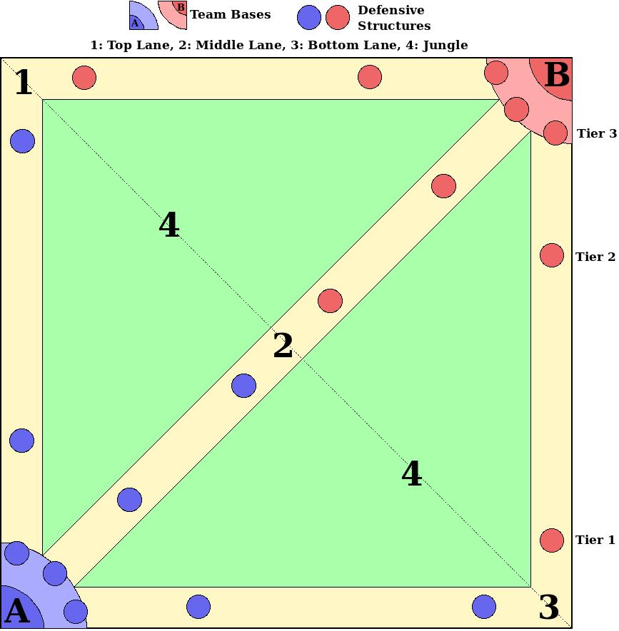
Introduction Heroes of newerth
Game Objective
Entities
Heroes of Newerth as Testing Grounds
Open code base
Access to game console
Existing AI
Pre-defined behaviors (general and hero-specific)
Behavior priority ordering by computing utility values
Notes:
Lets shortly discuss moba games themself.
Two teams of 5 players each play against each other on a predefined map (as can be seen in the figure).
The objective of each team is to destroy the opponents ”base”.
In order to do so, each team must first destroy the defensive structures that lead into the base (so in any of the lanes).
Every player controls a different character, also called hero. They have access to four abilities as well as a normal attack that can be used to battle opponents or support allies.
Every 30s 3 creep waves spawn in each base. They walk along the three lanes towards the opposing team’s base. Creeps, as well as enemy heroes and defensive structures, can be killed by heroes to gain gold and experience, both of which will make the hero stronger.
During the game opposing heroes will encounter each other in the various lanes. This is what this thesis will focus on.
HoN was idea as testing grounds because it provided an open source code base as well as a sandbox-like testing environment. The existing AI is based on predefined behaviors, which are evaluated (and ranked in priority) anew every time a decision needs to be made.

Slide 6
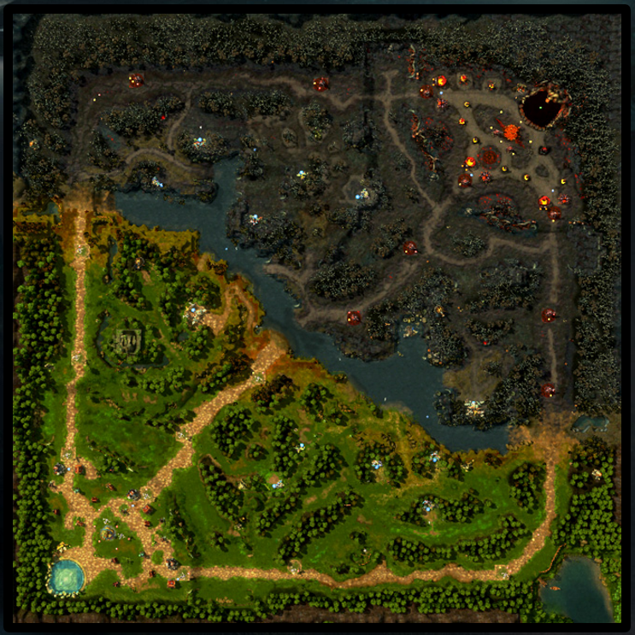

Slide 7
Outline
Introduction
Related Work
Methods
Application
Experiments and Results
Conclusion and Future Work

Slide 8
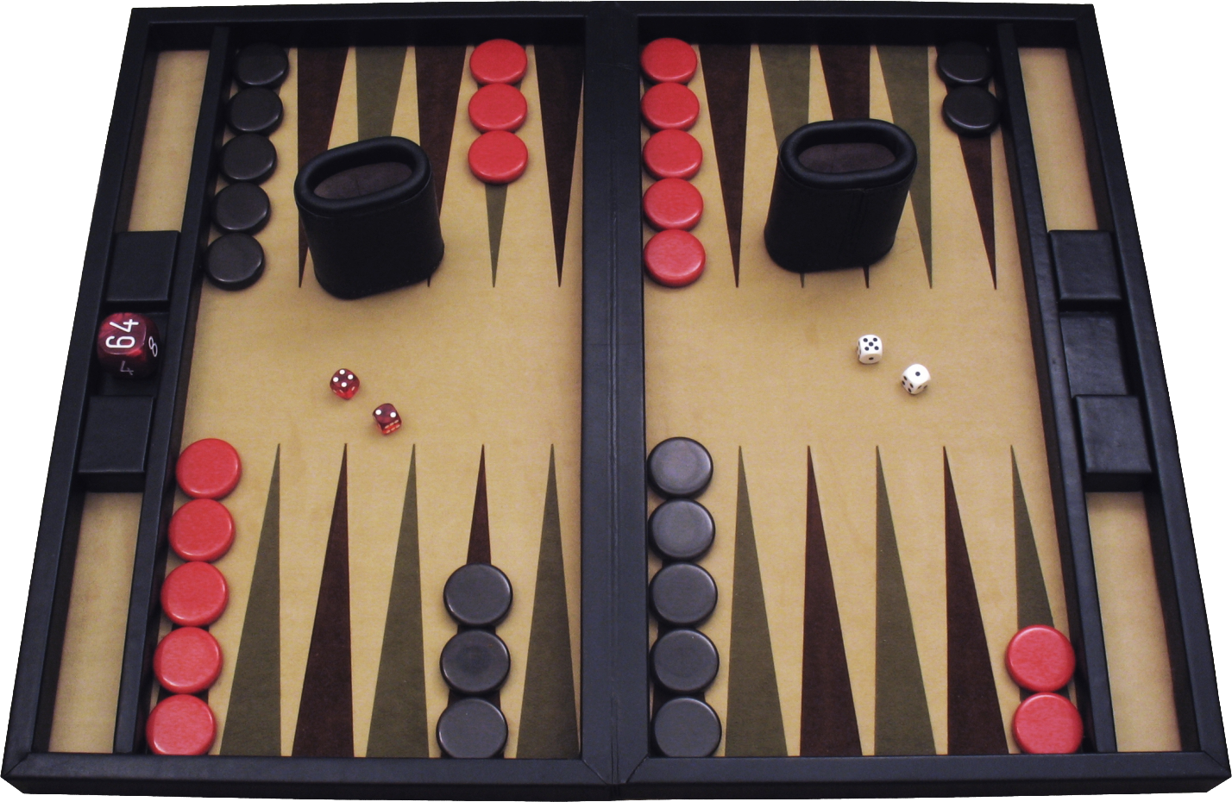
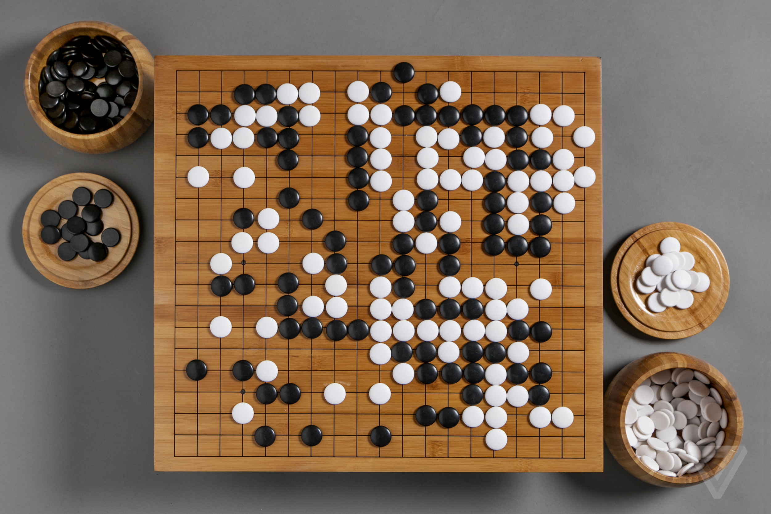
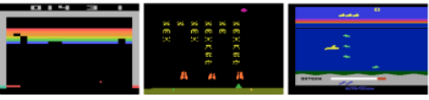
Related Work
AlphaGo (Silver et al, 2016)
Deep Neural Networks
Tree Search using Monte-Carlo Simulation
Supervised & Reinforcement Learning (expert & self-play)
TD-Gammon (Tesauro, 1995)
Neural Network to evaluate players chance of winning from current board state
Reinforcement Learning (self-play only)
Playing Atari Games (Mnih et al, 2013)
Convolutional Neural Network
Applied to 7 different games
Reinforcement Learning
Notes:
These are some related studies that have been done in games that use rl and neural networks.
However, as good as no work has been done for moba games, certainly no learning agents.

Slide 9
Outline
Introduction
Related Work
Methods
Neural Networks (Supervised Learning)
Reinforcement Learning
Application
Experiments and Results
Conclusion and Future Work

Slide 10
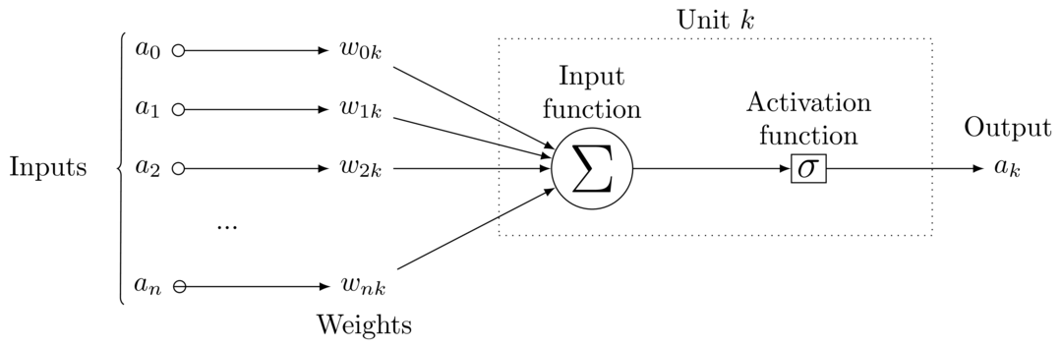
Methods Neural networks
A Neural Network Neuron
Notes:
Neural networks are inspired by the human brain, but essentially are nothing more than mathematical models defining a function.
Neural networks consist of a large collection of neuron units. Such a neuron is displayed up here. A neuron has connections leading into it, that provide it with input data. And every link is associated with a weight. furthermore Each neuron has an activation function, which converts the weighted sum of data into its output activation.
When using neural networks to model a function the objective is to find the values of the weights such that it accurately represents the problem at hand.

Slide 11
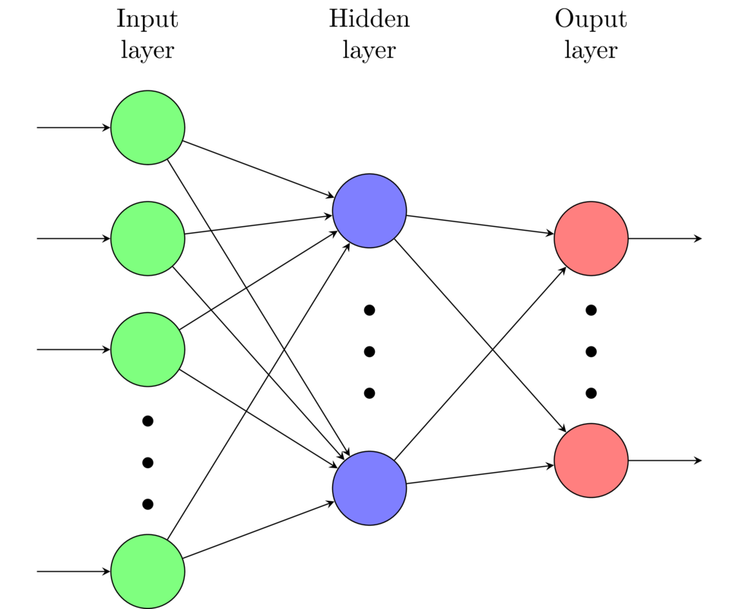
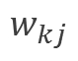
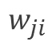
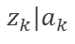
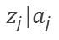
Methods Neural networks
$$w_{ji}$$
$$z_{j}|a_{j}$$
$$w_{kj}$$
$$z_{k}|a_{k}$$
Notes:
When we connect such neurons in a layered network as shown here, it is possible to model any arbitrary complex function.
Here we have a feed-forward neural network.
Neural networks are supervised learning models. Thus, nn learn by being given training examples as well as the desired network output. Its accuracy is then measured by comparing Network output vs target output.
Backpropagation is a method used to learn the network to adjust it’s weights according to the target function.

Slide 12
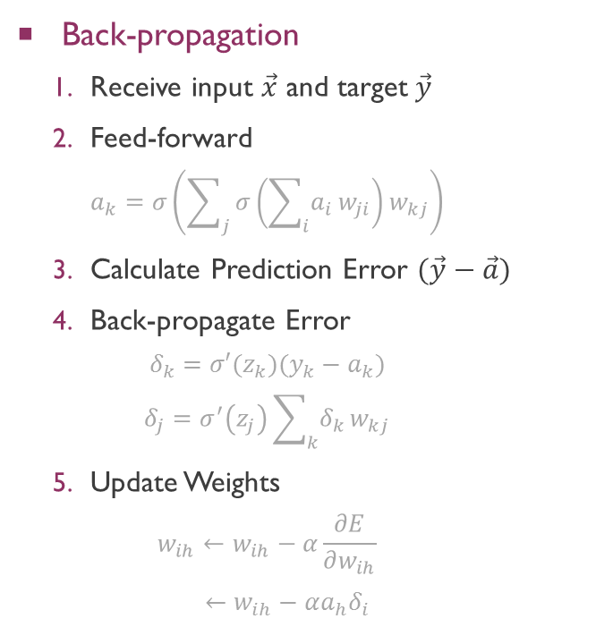
Methods Neural networks
Back-propagation
Receive input $\vec{x}$ and target$\vec{y}$
Feed-forward
$$a_{k}=σ\left(\sum_{j}{σ\left(\sum_{i}{a_{i}}w_{ji}\right)}w_{kj}\right)$$
Calculate Prediction Error $(\vec{y}−\vec{a})$
Back-propagate Error
$$δ_{k}=σ′(z_{k})(y_{k}−a_{k})$$
$$δ_{j}=σ^{′}\left(z_{j}\right)\sum_{k}{δ_{k}}w_{kj}$$
Update Weights
$$w_{ih}←w_{ih}−α\frac{∂E}{∂w_{ih}}$$
$$_{ } ←w_{ih}−α{a_{h}δ}_{i}$$
$$w_{ji}$$
$$z_{j}|a_{j}$$
$$w_{kj}$$
$$z_{k}|a_{k}$$
Notes:
When we connect such neurons in a layered network as shown here, it is possible to model any arbitrary complex function.
Here we have a feed-forward neural network.
Neural networks are supervised learning models. Thus, nn learn by being given training examples as well as the desired network output. Its accuracy is then measured by comparing Network output vs target output.
Backpropagation is a method used to learn the network to adjust it’s weights according to the target function.

Slide 13

Methods Neural networks
Back-propagation
Receive input $\vec{x}$ and target$\vec{y}$
Feed-forward
$$a_{k}=σ\left(\sum_{j}{σ\left(\sum_{i}{a_{i}}w_{ji}\right)}w_{kj}\right)$$
Calculate Prediction Error $(\vec{y}−\vec{a})$
Back-propagate Error
$$δ_{k}=σ′(z_{k})(y_{k}−a_{k})$$
$$δ_{j}=σ^{′}\left(z_{j}\right)\sum_{k}{δ_{k}}w_{kj}$$
Update Weights
$$w_{ih}←w_{ih}−α\frac{∂E}{∂w_{ih}}$$
$$_{ } ←w_{ih}−α{a_{h}δ}_{i}$$
Notes:
BP builds on the concepts of the gradient descent: we want to minimize the networks cost function (which represents how accurate our network is). Basic idea: we don’t really know where the minimum is, but given a new training example, we can make a small step in the direction of which we suspect the minimum to be (as indicated by the training example), step by step.

Slide 14
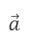
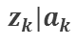
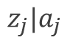
Methods Neural networks
Back-propagation
Receive input $\vec{x}$ and target$\vec{y}$
Feed-forward
$$a_{k}=σ\left(\sum_{j}{σ\left(\sum_{i}{a_{i}}w_{ji}\right)}w_{kj}\right)$$
Calculate Prediction Error $(\vec{y}−\vec{a})$
Back-propagate Error
$$δ_{k}=σ′(z_{k})(y_{k}−a_{k})$$
$$δ_{j}=σ^{′}\left(z_{j}\right)\sum_{k}{δ_{k}}w_{kj}$$
Update Weights
$$w_{ih}←w_{ih}−α\frac{∂E}{∂w_{ih}}$$
$$_{ } ←w_{ih}−α{a_{h}δ}_{i}$$
$$z_{j}|a_{j}$$
$$z_{k}|a_{k}$$
$$\vec{a}$$
Notes:
forward propagation (passing the input signal through a network while multiplying it by the respective weights) to compute an output

Slide 15
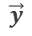
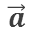
Methods Neural networks
Back-propagation
Receive input $\vec{x}$ and target$\vec{y}$
Feed-forward
$$a_{k}=σ\left(\sum_{j}{σ\left(\sum_{i}{a_{i}}w_{ji}\right)}w_{kj}\right)$$
Calculate Prediction Error $(\vec{y}−\vec{a})$
Back-propagate Error
$$δ_{k}=σ′(z_{k})(y_{k}−a_{k})$$
$$δ_{j}=σ^{′}\left(z_{j}\right)\sum_{k}{δ_{k}}w_{kj}$$
Update Weights
$$w_{ih}←w_{ih}−α\frac{∂E}{∂w_{ih}}$$
$$_{ } ←w_{ih}−α{a_{h}δ}_{i}$$
$$\vec{a}$$
$$\vec{y}$$
Notes:
Cost: comparing the calculated output and the known, correct target output
Now we want to propagate this error back through the network to adjust weights.

Slide 16
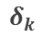
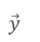
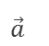
Methods Neural networks
Back-propagation
Receive input $\vec{x}$ and target$\vec{y}$
Feed-forward
$$a_{k}=σ\left(\sum_{j}{σ\left(\sum_{i}{a_{i}}w_{ji}\right)}w_{kj}\right)$$
Calculate Prediction Error $(\vec{y}−\vec{a})$
Back-propagate Error
$$δ_{k}=σ′(z_{k})(y_{k}−a_{k})$$
$$δ_{j}=σ^{′}\left(z_{j}\right)\sum_{k}{δ_{k}}w_{kj}$$
Update Weights
$$w_{ih}←w_{ih}−α\frac{∂E}{∂w_{ih}}$$
$$_{ } ←w_{ih}−α{a_{h}δ}_{i}$$
$$δ_{k}$$
$$\vec{a}$$
$$\vec{y}$$
Notes:
We do this by computing the gradient of the network outputs with respect to weights over one trainíng example.
Partial derivative of network’s activation output
And we compute the error at the units (delta)

Slide 17
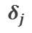
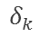
Methods Neural networks
Back-propagation
Receive input $\vec{x}$ and target$\vec{y}$
Feed-forward
$$a_{k}=σ\left(\sum_{j}{σ\left(\sum_{i}{a_{i}}w_{ji}\right)}w_{kj}\right)$$
Calculate Prediction Error $(\vec{y}−\vec{a})$
Back-propagate Error
$$δ_{k}=σ′(z_{k})(y_{k}−a_{k})$$
$$δ_{j}=σ^{′}\left(z_{j}\right)\sum_{k}{δ_{k}}w_{kj}$$
Update Weights
$$w_{ih}←w_{ih}−α\frac{∂E}{∂w_{ih}}$$
$$_{ } ←w_{ih}−α{a_{h}δ}_{i}$$
$$δ_{j}$$
$$δ_{k}$$
$$\vec{a}$$
$$\vec{y}$$

Slide 18
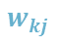

Methods Neural networks
Back-propagation
Receive input $\vec{x}$ and target$\vec{y}$
Feed-forward
$$a_{k}=σ\left(\sum_{j}{σ\left(\sum_{i}{a_{i}}w_{ji}\right)}w_{kj}\right)$$
Calculate Prediction Error $(\vec{y}−\vec{a})$
Back-propagate Error
$$δ_{k}=σ′(z_{k})(y_{k}−a_{k})$$
$$δ_{j}=σ^{′}\left(z_{j}\right)\sum_{k}{δ_{k}}w_{kj}$$
Update Weights
$$w_{ih}←w_{ih}−α\frac{∂E}{∂w_{ih}}$$
$$_{ } ←w_{ih}−α{a_{h}δ}_{i}$$
$$w_{ji}$$
$$w_{kj}$$

Slide 19
Outline
Introduction
Related Work
Methods
Neural Networks (Supervised Learning)
Reinforcement Learning
Application
Experiments and Results
Conclusion and Future Work

Slide 20
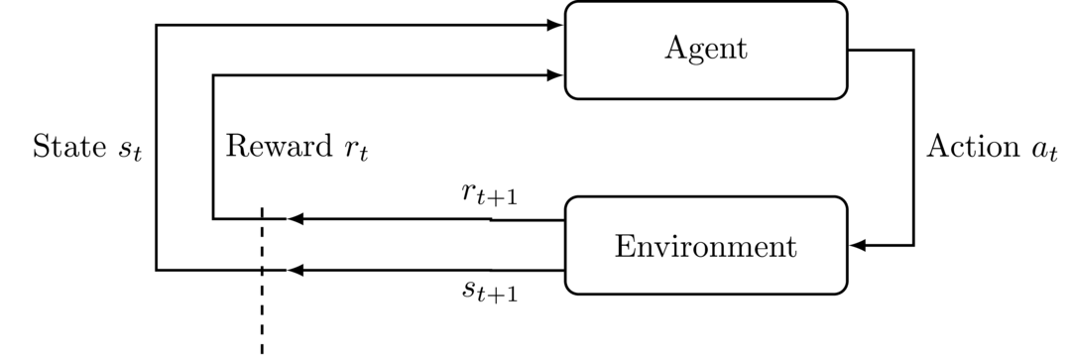
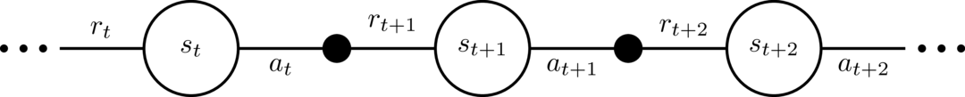
Methods Reinforcement Learning
Agent-Environment Interaction in Reinforcement Learning
Notes:
Reinforcement learning is a method of teaching agents to how to act within a specific environment. more precisely, by teaching agents behaviors using rewards and punishments.
Such an agent-environment interaction is shown here.

Slide 21
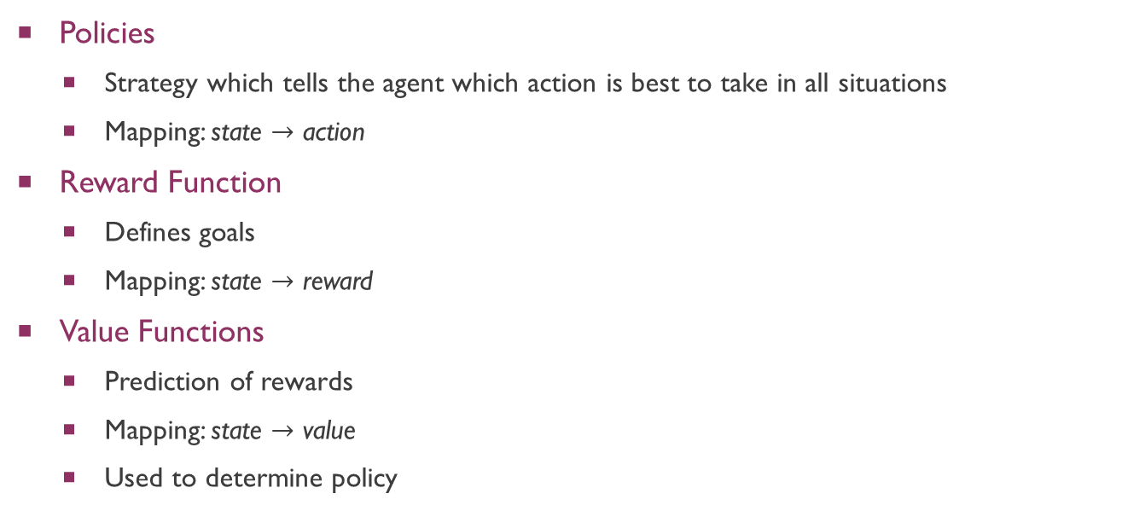
Methods Reinforcement Learning
Policies
Strategy which tells the agent which action is best to take in all situations
Mapping: state $→$ action
Reward Function
Defines goals
Mapping: state $→$ reward
Value Functions
Prediction of rewards
Mapping: state $→$ value
Used to determine policy
Notes:
Reinforcement learning ingredients: policy, reward function, value function
Rewards:
- Immediate desirability of states
Values
More farsighted
Long-term desirability of states
Relationship between rewards and values: Without rewards there could be no values, and the only purpose of estimating values is to achieve more reward.
RL problems can be solved by estimating the value function e.g. using neural networks. Generally: iteratively improve approximation of value function.
Other ways: evolutionary algorithms

Slide 22
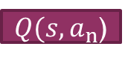

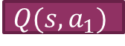
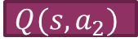
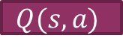
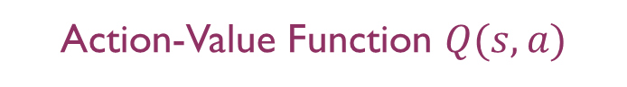

Methods Reinforcement Learning
State-Value Function $V(s)$
State
Network
$$V(s)$$
Action-Value Function $Q(s,a)$
State
Network
$$Q(s,a)$$
Action
$$Q(s,a_{1})$$
State
Network
$$Q(s,a_{2})$$
…
$Q(s,a_{n}$)
Notes:
State value
gives each state a value
Action value
gives each state-action pair a value

Slide 23
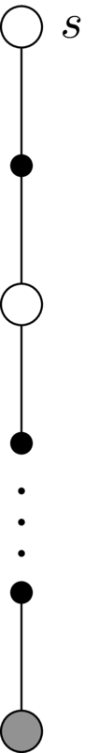
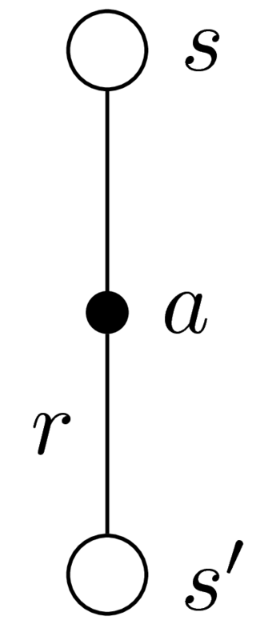
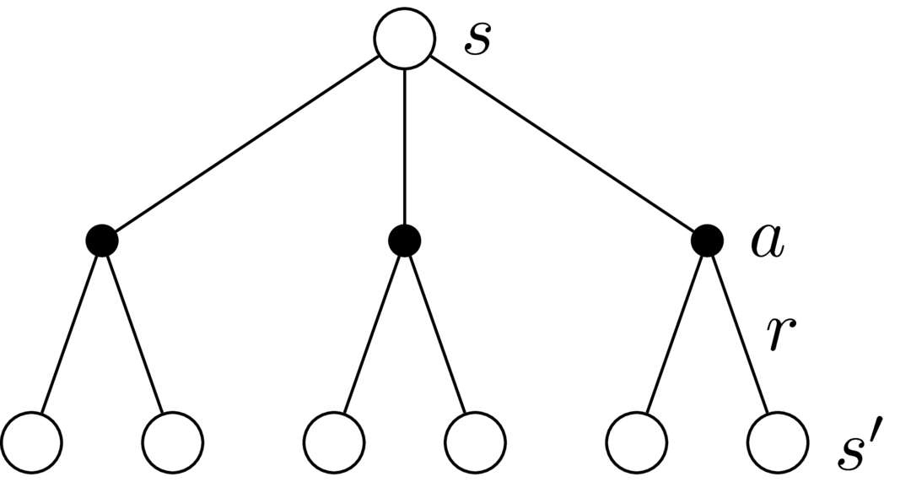
methods Reinforcement Learning
Value function approximation methods
Search Tree Evaluation
Monte-Carlo Methods
Temporal Difference, TD(0)
$$∙$$
$$∙$$
$$∙$$
Notes:
Search tree
value of a state is updated based on the values of all possible successor states & their probability of occurring
Requires perfect model of the environment (need to know all s, a and all s’ etc)
MC
Learn from experience
Pick a state, generate sample episode (until terminal state), update state based on all actions taken & states visited in that episode
Can only update after episode is finished
TD
TD methods are alternatives to Monte Carlo
Also uses samples: eg. TD(0) one sample transition from it to the immediately following state

Slide 24
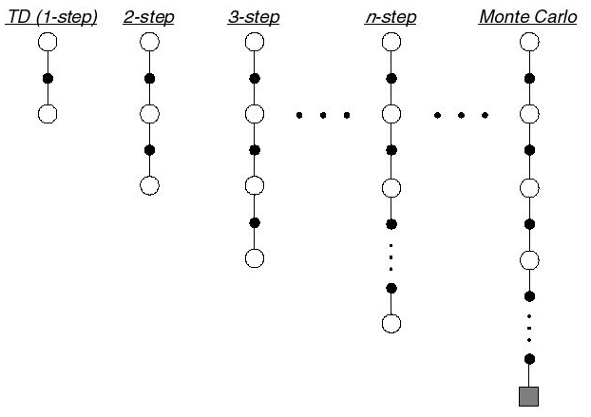
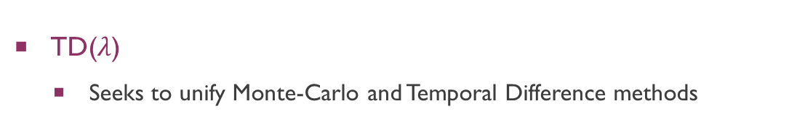
Methods Reinforcement Learning
TD($λ$)
Seeks to unify Monte-Carlo and Temporal Difference methods
Notes:
TD error
- New state $→$ are things better or worse?
Eligibility traces
- Recently visited states more impacted

Slide 25
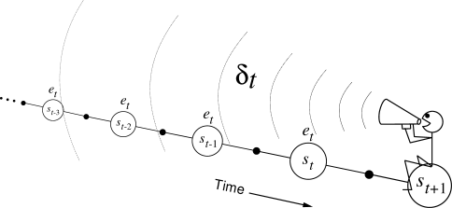
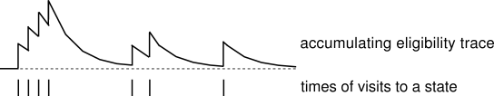
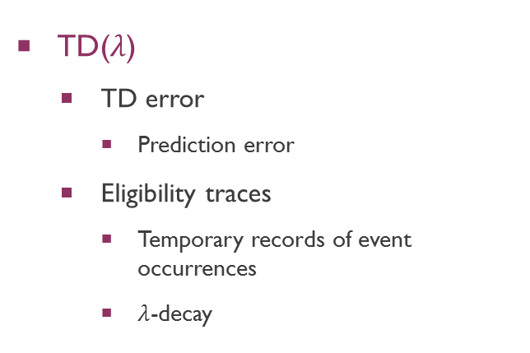
Methods Reinforcement Learning
TD($λ$)
TD error
Prediction error
Eligibility traces
Temporary records of event occurrences
$λ$-decay
Execute action
Calculate TD error (state prior vs post action)
Assign error backward in accordance to state’s eligibility trace
Update
Notes:
Two main components:
TD error
- New state $→$ are things better or worse?
Eligibility traces
Recently visited states more impacted
Eligibility trace to represent how recent a state’s gradient was computed, $λ$ decay
2. Networks output when in state s q(s,a) vs networks output after q(s’,a)
3. Shout the error backward over time; strength of voice decreases with temporal difference to $γλ$ – if our value function is represented by a neural networks we can use backpropagation!
T(0) as before; T(1) like MC but better: don’t have to wait until end of episode

Slide 26
Outline
Introduction
Related Work
Methods
Application
Experiments and Results
Conclusion and Future Work

Slide 27
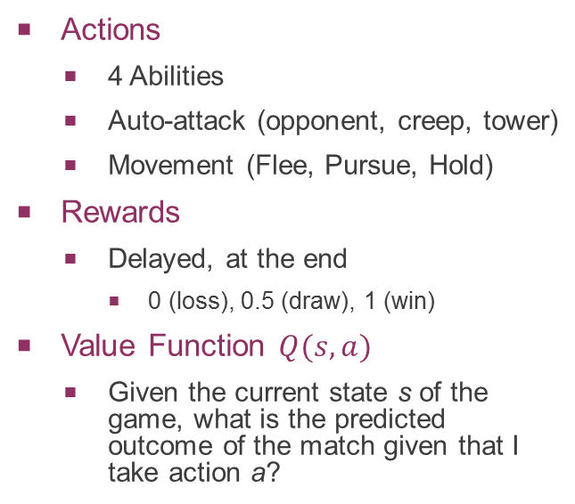
application RL model & NN
Environment
General
Health
Mana
Auto-Attack Reader & Range
Distance (between heroes and to center)
Creep aggro & health
Creep score
Tower aggro/range & health
Events
Action Availability
Action inrange
Special events (weakening or strengthening)
Last hit & deny potential
Creep spawn
Actions
4 Abilities
Auto-attack (opponent, creep, tower)
Movement (Flee, Pursue, Hold)
Rewards
Delayed, at the end
0 (loss), 0.5 (draw), 1 (win)
Value Function $Q(s,a)$
Given the current state s of the game, what is the predicted outcome of the match given that I take action a?
56 = 45 (environment) + 11 (actions) inputs
25 hidden units (1 hidden layer)
1 output
Notes:
Environment: stats about self and opponent

Slide 28
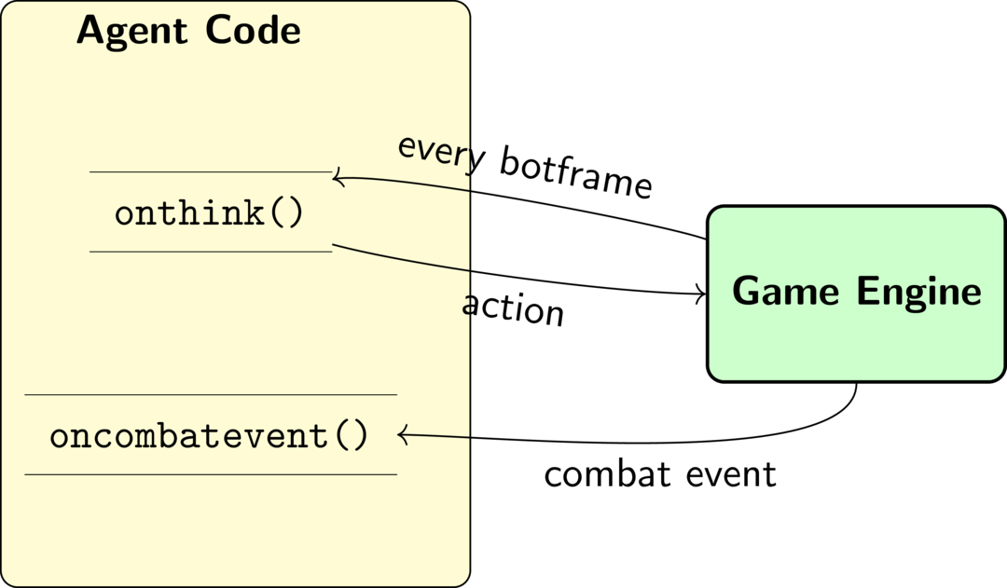
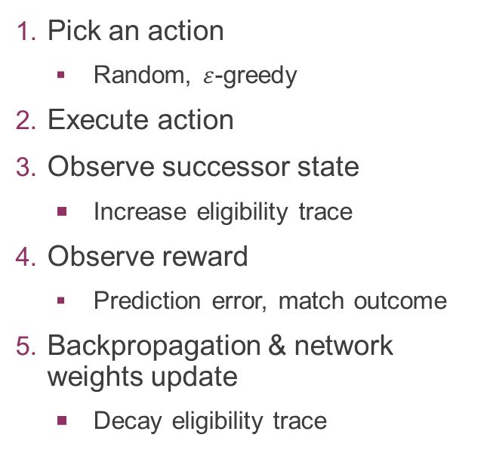
application implementation
Pick an action
Random, $ε$-greedy
Execute action
Observe successor state
Increase eligibility trace
Observe reward
Prediction error, match outcome
Backpropagation & network weights update
Decay eligibility trace
Notes:
In spirit of TD lambda algorithm with bp of neural networks
Bot frame 1/20 of a second – every 5 calls we make a decision
Decrease random chance after each match

Slide 29
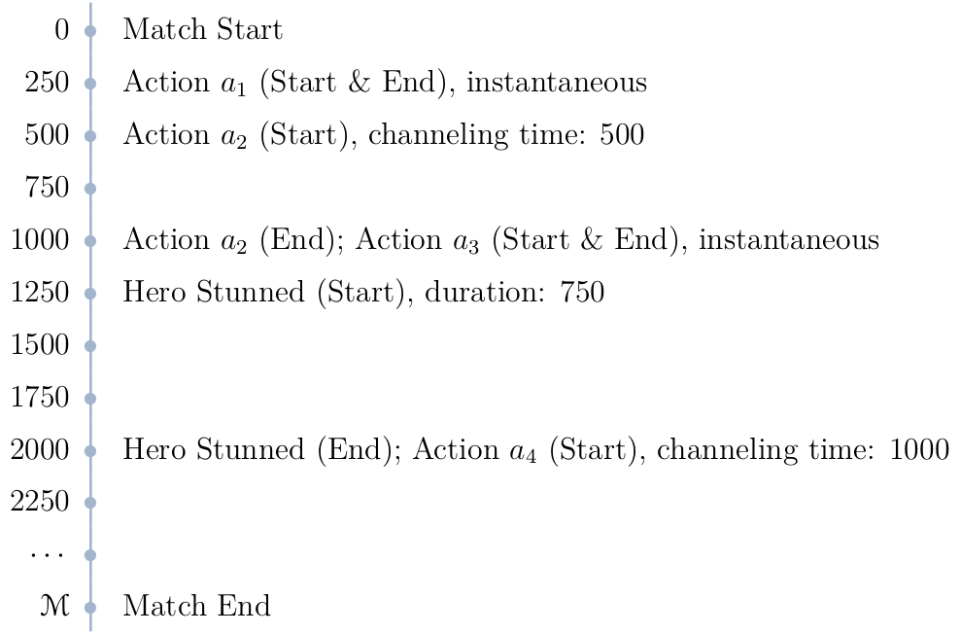
application Game mechanisms
Game Mechanisms
Instant vs channel actions
Temporary inability to act
Notes:
May not be able to act, but learn at regular intervals

Slide 30
Outline
Introduction
Related Work
Methods
Application
Experiments and Results
Conclusion and Future Work

Slide 31
Experiments and Results Experiment structure
Limitations
Stage 1
Is our agent learning?
Neural network structure?
State 2
Can we detect incremental improvements?
First benchmark test!
Stage 3
Extending the Game Scenario
What have we learned?
Benchmark test
Notes:
takes time to run test. Anything between a few seconds upto well over 5 minutes depending on parameters and training accomplished. Game allows speed up but only by 5-6 as fast. Limits the amounts of tests that can be run. Thus further tests were run even past writing the thesis report. I will now present the most uptodate results.
Stage we just want to get a feel for if this can be done
Stage About seeing learning, first benchmark test
1&2 stage only consider hero vs hero interaction. No other gaem elements
3. Stage More complex (more related to the game) and final test

Slide 32
Experiments and Results Results
Stage 1
Are our agents learning?
Can we observe intelligence?
What should the network structure look like?

Slide 33
Self-Play: Predator vs Swiftblade
$$(α=0.2, 40000 matches each)$$
Notes:
Alpha is a guess based on previous work. 40k matches for varying lambda. Play against self, each own network.
Normally, never two of the same heroes in a game. So picked two really easy heroes.

Slide 34
Self-Play: Predator vs Swiftblade
$$(α=0.2, 40000 matches each)$$
Win
percent
Value for $λ$
Notes:
Swiftblade clearly dominating. Not balanced, unfair
However, lets look at the network’s outputs (win predictions)

Slide 35
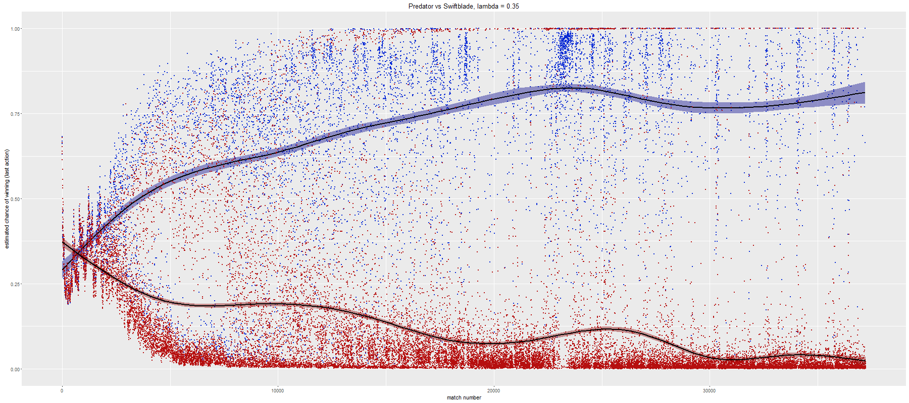
Self-Play: Predator vs Swiftblade
$$(α=0.2, λ=0.35, 40000 matches each)$$
Win
prediction of
last executed
action
Match number
Blue: wins; Red: losses
Predator
Averaging over win percent of 100 evenly sized groups of successive matches
Notes:
Lines: conditional mean and confidence interval
Blue: agent won, red: agent lost
Below you can just see for comparision its win percent
Looses a lot -> good at predicting losses
Not so good at predicting wins

Slide 36
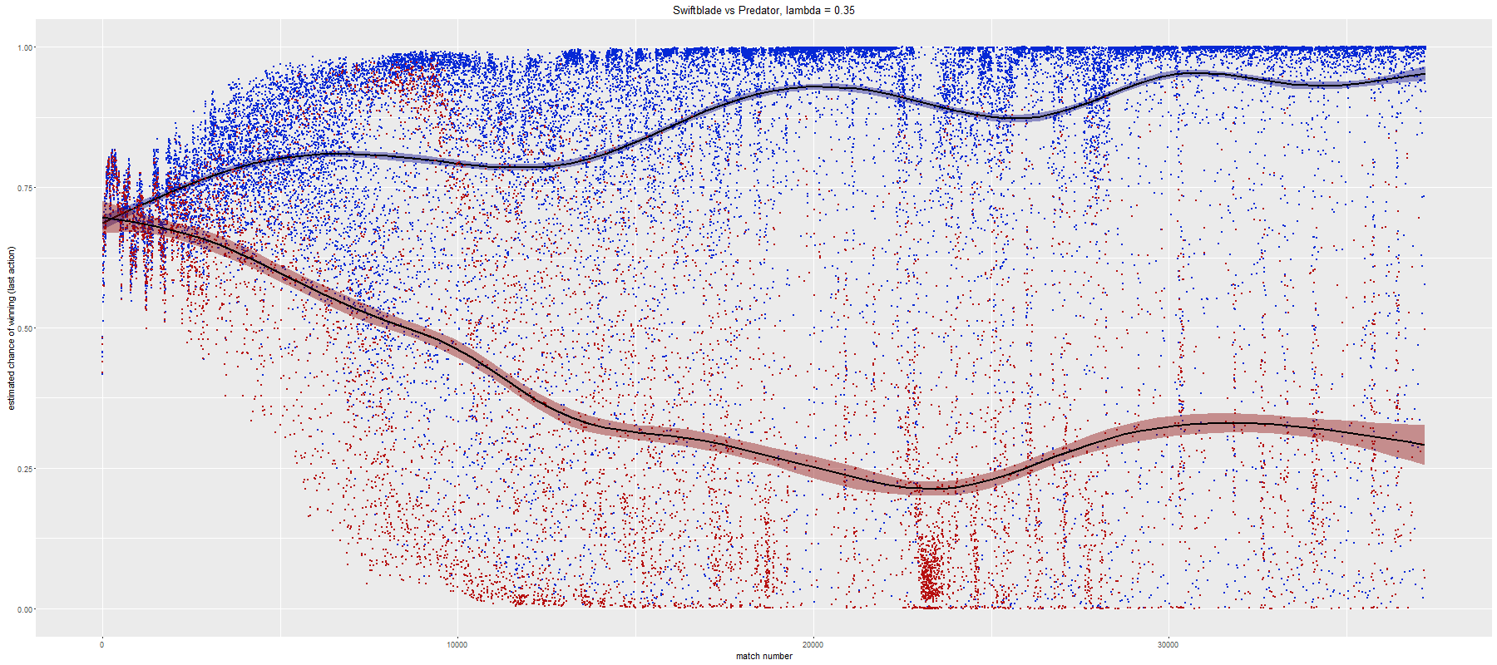
Self-Play: Predator vs Swiftblade
$$(α=0.2, λ=0.35, 40000 matches each)$$
Win
prediction of
last executed
action
Match number
Blue: wins; Red: losses
Swiftblade
Averaging over win percent of 100 evenly sized groups of successive matches
Notes:
Wins a lot -> good at pred wins, bad at losses

Slide 37
Experiments and Results Results
Balancing & Variations
Notes:
Two different heroes seemed bad test
Yes we could see one clearly found a strategy to win almost all the time, but is this because of good learning or because of

Slide 38

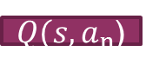


PredatorA vs PredatorB $\left(α=0.2, 30000 matches each\right)$
State
$$Q(s,a_{1})$$
Action
Network
$$Q(s,a)$$
State
Network
$$Q(s,a_{2})$$
…
$Q(s,a_{n}$)

Slide 39
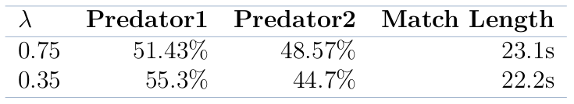





PredatorA vs PredatorB $\left(α=0.2, 30000 matches each\right)$
State
$$Q(s,a_{1})$$
Action
Network
$$Q(s,a)$$
State
Network
$$Q(s,a_{2})$$
…
$Q(s,a_{n}$)
$$PredatorA, λ=0.35$$
$x$ axis: match number,
$y$ axis: win prediction of last action taken
Blue: wins; Red: losses
Notes:
Again self play
Right side seems to move towards convergence faster
Can also see, more competitve now as same hero on both sides.

Slide 40
Experiments and Results Results
Stage 2
Can we detect incremental improvement?
First benchmark test!

Slide 41
SuccubusA vs SuccubusB $\left(α=0.3, λ=0.9, 60000 matches by selfplay\right)$
10000 states picked uniformly at random from 10000 random walk games.
Notes:
Want to investigate neural network’s predictions in relation to updating the weights during training

Slide 42







SuccubusA vs SuccubusB $\left(α=0.3, λ=0.9, 60000 matches by selfplay\right)$
10000 states picked uniformly at random from 10000 random walk games.
Starting weights (random)
After 30000 matches
After 60000 matches
$x$ axis: network’s prediction - $y$ axis: random state number

Slide 43
Succubus Learning Agent (starting with random weights) vs Game AI
$$(α=0.3, λ=0.7, 15000 matches)$$
Notes:
First benchmark test!

Slide 44

Succubus Learning Agent (starting with random weights) vs Game AI
$$(α=0.3, λ=0.7, 15000 matches)$$
Win
prediction of
last executed
action
Match number
Blue: wins; Red: losses
Learning Agent
Averaging over win percent of 100 evenly sized groups of successive matches

Slide 45
Experiments and Results Results
Stage 3
Increasing the difficulty.
Applying what we have learned.

Slide 46

Experiments and Results Experimental Setup
Win Conditions
Hero dies
15 creep kills
Tower is destroyed

Slide 47

Experiments and Results Experimental Setup
The Hero: Succubus
Damage Reduction
Damage + Heal Self
Damage + Sleep
Damage + Stun + Mana Drain
Notes:
Hero has a lot of different spells made it a well rounded hero to test

Slide 48

Learning Agent (using pretrained weights after 50000 self-play matches) vs Game AI
$$(α=0.3, 100 matches each)$$
Notes:
Take our agent let it play 50 k games against another same version agent.
Then use the learned weights and play against game AI 100 matches

Slide 49
Learning Agent (using pretrained weights after 50000 self-play matches) vs Game AI
$$(α=0.3, 100 matches each)$$
Avg. Win
Percent
Value for $λ$
Notes:
Look at two ends of the spectrum, lambda 0.9 and 0.7
Larger lambda values: actions further in the past are credited/blamed for outcome => good to establish base line for weights (believes that 1. action can impact how the game will turn out)
Smaller lambda values: moment-to-moment decision making (believes that independent of how I got in this situation, it only matters what I do now)

Slide 50

Notes:
Exmaple of where does the agent win?

Slide 51
Notes:
Example of where the agent loses (which happens most of the time)

Slide 52
Experiments and Results Results
Adjustments
Notes:
Agent generally had a good idea, also shown by test in stage 2. our agent knows how to fight.
but now things are more complex and it does stupid things that could be avoided. So small modification: whenever the agent has creep or tower aggro (takes damage), the action set is restricted to only fleeing. To furthermore prevent such situations, the hero cannot be in front of its own creep wave.
All other actions are still the same. Still dedices general retreats, attacks, what abilities to use, what to hit etc

Slide 53
Learning Agent (using pertained weights) vs Game AI
$$(α=0.3, λ=0.9, 100 matches each)$$

Slide 54
Learning Agent (using pertained weights) vs Game AI
$$(α=0.3, λ=0.9, 100 matches each)$$
Avg. Win
Percent
Weights obtained after number of training matches (self-play)
Succubus A
Averaging over win percent of 100 evenly sized groups of successive matches (self-play)

Slide 55
Learning Agent (using pertained weights) vs Game AI
$$(α=0.3, λ=0.9, 100 matches each)$$
Avg. Win
Percent
Weights obtained after number of training matches (self-play)
Succubus B
Averaging over win percent of 100 evenly sized groups of successive matches (self-play)

Slide 56
Learning Agent (using pertained weights) vs Game AI
$$(α=0.3, λ=0.1, 100 matches each)$$

Slide 57
Learning Agent (using pertained weights) vs Game AI
$$(α=0.3, λ=0.1, 100 matches each)$$
Avg. Win
Percent
Weights obtained after number of training matches (self-play)
Succubus A
Averaging over win percent of 100 evenly sized groups of successive matches (self-play)

Slide 58
Learning Agent (using pertained weights) vs Game AI
$$(α=0.3, λ=0.1, 100 matches each)$$
Avg. Win
Percent
Weights obtained after number of training matches (self-play)
Succubus B
Averaging over win percent of 100 evenly sized groups of successive matches (self-play)
Notes:
Why is succB dominating the AI even though in self play it had a tendens to lose? Mainly, because of what we saw earlier. Succ B would play very aggressive (see 20k), the opponent would start to just hide under its tower (30k+)
Now lets look at a couple of plays this agent makes.

Slide 59

Notes:
Insta kill

Slide 60

Notes:
The AI strikes back! Not.

Slide 61

Notes:
Wait and bait game

Slide 62

Learning Agent vs Game AI
Start from random weights; 10000 matches vs Game AI; $α=0.3, λ=0.9$
4000 evaluation games
Notes:
Finally, wanted to see other learning than through selfplay
What if we learned only against game ai?

Slide 63

Learning Agent vs Game AI
Start from random weights; 10000 matches vs Game AI; $α=0.3, λ=0.9$
Further 4000 evaluation games
Averaging over win percent of 100 evenly sized groups of successive matches (self-play)
Notes:
Agent actually developed a different strategy than the ones during self play.
Self play -> fastest way to win proved to be killing opponent, so farming didn’t matter
Against AI -> super hard to start out as a stupid agent, against an AI that somewhat knows what its doing. Those killing the AI wasn’t an option. Hence instead it developed the strategy of farming and pushing creeps.

Slide 64


Slide 65
Experiments and Results Observations
Game AI
Easily ”intimidated”
Not aware of own and opponents win conditions
Doesn’t understand game goals
Doesn’t alternate between behaviors well (e.g. farming and harrassing)
Learning Agent
Understands the different game goals → different strategies!

Slide 66
Outline
Introduction
Related Work
Methods
Application
Experiments and Results
Conclusion and Future Work

Slide 67


Conclusion
Learning Agent for HoN
Reinforcement learning (TD($λ$)) in combination with neural networks
Learning through self-play with little game knowledge
Achievements
Diverse game-play strategies
Focus on harassing & killing the opponent
Focus on farming & pushing creep waves
Competitive at level of HoN Game AI
Simple Scenario | Extended Scenario
Train vs Game AI 85% win percent $α=0.3, λ=0.7$ | Train by self-play 70% win percent $α=0.3, λ=0.9$ 90% win percent $α=0.3, λ=0.1$ Train vs Game AI 65% win percent $α=0.3, λ=0.9$

Slide 68
Future Work
Testing
Further parameter variation
Optimal neural network features
Intermediate rewards
Playing against humans
Behaviors instead of actions
Broader Implementation
Appliable against multiple opponent heroes
Even more exensive
Different Concepts/Methods
Supervised Learning using human expert plays
From feed-forward to recurrent or convolutional multi-layer networks
Other MOBA games

Slide 69
Thank you for your Attention

